Slide 1

UNIT I
18CSC301T – FORMAL LANGUAGE AND AUTOMATA
1

Slide 2
UNIT 1
Introduction to Automaton
Mathematical concepts
Formal Languages: Strings, Languages, Properties
Finite Representation : Regular Expressions
Problems related to regular expressions
Finite Automata :Deterministic Finite Automata
Nondeterministic Finite Automata
Finite Automaton with €- moves
Problems related to Deterministic and Nondeterministic Finite Automata
Problems related to Finite Automaton with €- moves
Minimization of DFA
Problems related to Minimization of DFA
Regular Languages : Equivalence of Finite Automata and Regular Languages
Equivalence of Finite Automata and Regular Grammars
Problems related to Equivalence of Finite Automata and Regular Languages and Regular Grammars
Variants of Finite Automata :Two-way Finite Automaton Mealy Machines
Properties of Regular Languages: Closure Properties
Set Theoretic Properties & Other Properties
Pumping Lemma
2

Slide 3
Introduction of Automaton
An automata is an abstract self-propelled computing device which follows a predetermined sequence of operations automatically.
Automata-based programming is a programming paradigm in which the program or its part, is thought as a model of a finite state machine or any other formal automation.
What is Automata Theory?
Automata theory is the study of abstract computational devices
Abstract devices are (simplified) models of real computations
Computations happen everywhere: On your laptop, on your cell phone, in nature, …
Example:
input: switch
output: light bulb
actions: flip switch
states: on, off
BATTERY
3

Slide 4
Electric Switch
Fan Regulator
Automatic door controller
Binary string with divisible by 4
4

Slide 5
Simple Computer
Example:
input : switch
Output : light bulb
Actions : flip switch
States : on, off
bulb is on if and only if there was an odd number of flips
OTHER EXAMPLES
Electric Switch
Fan Regulator
Automatic door controller
Binary string with divisible by 4
BATTERY
f
start
off
on
f
5

Slide 6
Types of Automata
finite automata | Devices with a finite amount of memory. Used to model “small” computers.
push-down automata | Devices with infinite memory that can be accessed in a restricted way. Used to model parsers, etc.
Turing Machines | Devices with infinite memory. Used to model any computer.
6

Slide 7
Introduction of Formal Proof - Basic Definitions
1. Alphabet - a finite set of symbols.
Notation: Σ .
Examples: Binary alphabet {0,1}, English alphabet {a,...,z,!,?,...}
2. String over an alphabet Σ - a finite sequence of symbols from Σ.
Notation: (a) Letters u, v, w, x, y, and z denote strings.
(b) Convention: concatenate the symbols. No parentheses or commas used.
Examples: 0000 is a string over the binary alphabet.
a!? is a string over the English alphabet.
7

Slide 8
3. Empty string: e or ε denotes the empty sequence of symbols.
4. Language over alphabet Σ - a set of strings over Σ.
Notation: L.
Examples:
{0, 00, 000, ...} is an "infinite" language over the binary alphabet.
{a, b, c} is a "finite" language over the English alphabet.
5. Empty language - empty set of strings. Notation: Φ.
6. Binary operation on strings: Concatenation of two strings u.v - concatenate the symbols of u and v.
Notation: uv
Examples:
00.11 = 0011.
ε.u = u.ε = u for every u. (identity for concatenation)
8

Slide 9
Binary relations on strings
Prefix - u is a prefix of v if there is a w such that v = uw.
Examples:
ε is a prefix of 0 since 0 = ε0
apple is a prefix of appleton since appleton = apple.ton
Suffix - u is a suffix of v if there is a w such that v = wu.
Examples:
0 is a suffix of 0 since 0 = ?
ton is a suffix of appleton since ?
9

Slide 10
Substring - u is a substring of v if there are x and y such that v = xuy.
Examples:
let is a substring of appleton since appleton = app.let.on
0 is a substring of 0 since 0 = epsilon.0.epsilon
Observe that prefix and suffix are special cases
of substring.
10

Slide 11
Applications of the Concepts AND New Developments
Applications include:
Text processing (editors, etc.)
Compiler design
Verification through model checking
Development’s include :
DNA Computing
Quantum Turing Machines
11

Slide 12
Introduction to Mathematical concepts
Inductive Proof
Deductive Proof
12

Slide 13
INDUCTIVE PROOF
It is a special form of proof that deals about the objects in recursion.
Induction Principle:
If we prove S(i) and we prove that for all n>=I, S(n)=>S(n+1), then we may conclude that s(n) for all n>=1.
It has two parts.
1.Basis part.
2.Inductive part.
13

Slide 14
Basis step: We have to show S(i) for a particular integer value “i”, here “i “ may be zero or one.
Inductive step: We assume n>=i, where “i “ is the basis integer and we have to show that if S(n) then S(n+1) i.e., S(n) =>S(n+1).
14

Slide 15
Problems
Prove by an induction method on “n”
i=0 ∑ n i2 =((n(n+1)(2n+1))/6).
Solution:
i=0 ∑ n i2 =((n(n+1)(2n+1))/6). ----> Equ 1
Induction Principle:
If we prove S(i) and we prove that for all n>=I, S(n)=>S(n+1), then we may conclude that s(n) for all n>=1.
15

Slide 16
Basis:
Put n=0 in the equ 1
RHS= (0 (0+1) (2*0+1))/6 => 0
LHS = i=0 ∑ n (02) => 0
i.e., LHS = RHS.
Inductive step:
Put n =1 in the equ 1
S(n) = (n(n+1)(2n+1))/6.
= (2n3+2n2+n2+n)/6. ---> Equ 2
16

Slide 17
Put n=n+1 in the equ 1
S(n+1) => ((n+1)(n+2)(2n+3))/6.
=> ((n2+3n+2) (2n+3))/6.
=> (2n3+6n2+4n+3n2+9n+6)/6.->equ 3
From the induction principle:
= S(n+1) =S(n) + (n+1)2.
= ((2n3+3n2+n)/6) + (n+1)2
17

Slide 18
= ((2n³+3n²+n)/6) + (n²+2n+1)
Cross multiplying the ‘6’ on the numerator.
= ((2n³+3n²+n + 6n²+12n+6))/6.
= ((2n³+9n²+13n+6))/6. --🡪 equ 4
Equ 4 satisfies equ 3
Hence proved.
18

Slide 19
Deductive proof:
Consists of sequence of statements whose truth lead us from some initial statement called the hypothesis or the give statement to a conclusion statement.
Deductive Principle:
The theorem is proved when we go from a hypothesis H to a conclusion C is the atatement “ if H then C”. i.e C is deduced from H
19

Slide 20
Additional forms of proof:
Proof of sets
Proof by contradiction
Proof by counter example
20

Slide 21
Direct proof (AKA) Constructive proof: If p is true then q is true
Eg: if a and b are odd numbers then product is also an odd number. Odd number can be represented as 2n+1
a=2x+1, b=2y+1 product of a X b = (2x+1) X (2y+1)= 2(2xy+x+y)+1 = 2z+1 (odd number)
21

Slide 22
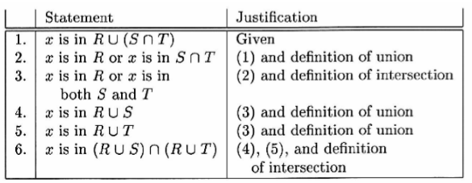
Proof by Contrapositve
The Contrapositive of the statement “ ifH then C” is “if not C then not H”.A statement and its contrapositive are either both true or both false.
Theorem R U (S ∩ T) =(R U S) ∩ (R U T)
22

Slide 23
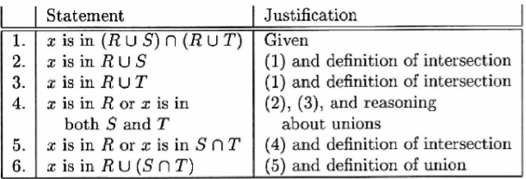
23

Slide 24
Proof by Contradiction:
H and not C implies falsehood.
24

Slide 25
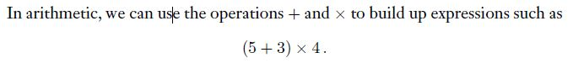
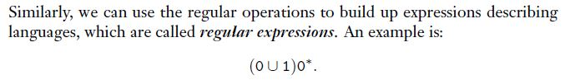
Regular Expressions
25

Slide 26

Regular Expressions
Regular expressions describe regular languages
Example:
describes the language
26

Slide 27
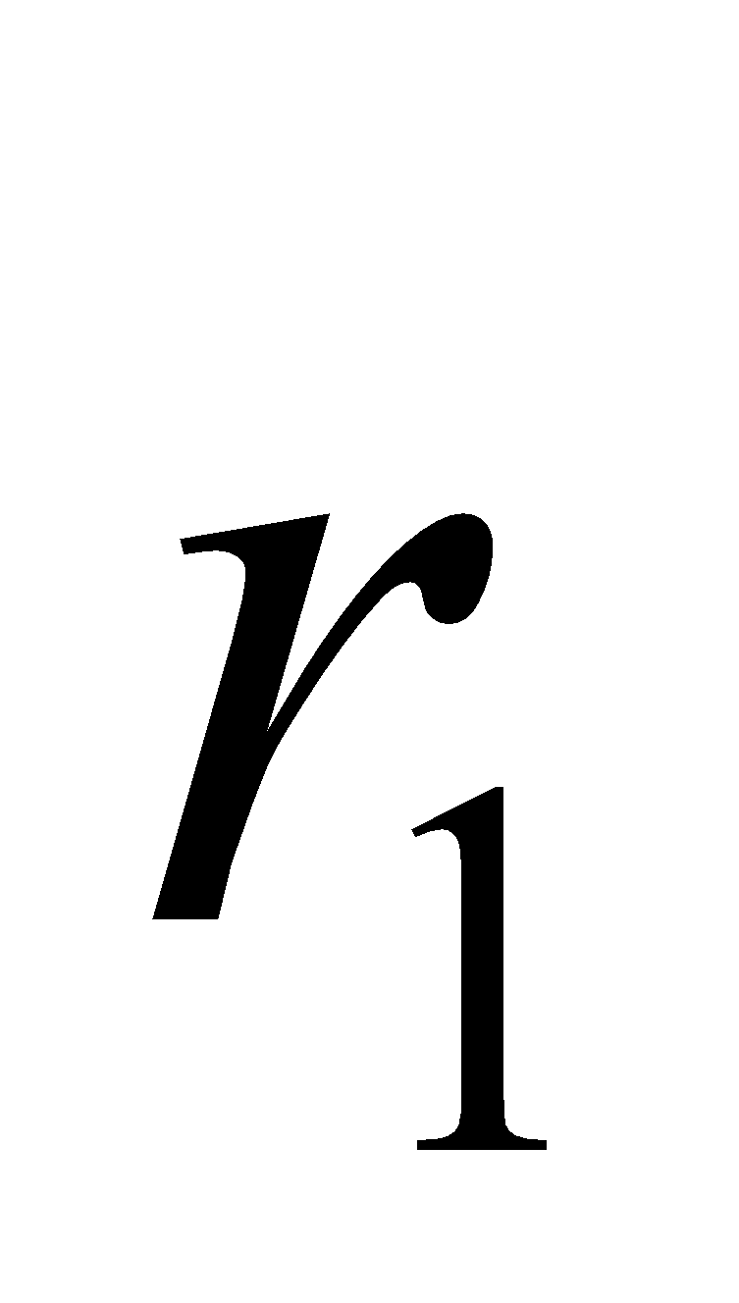
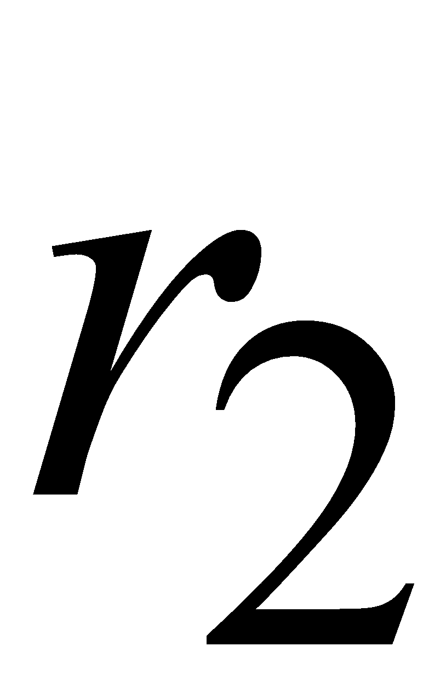
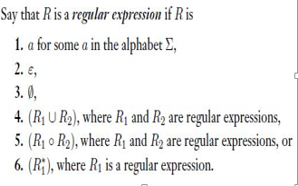
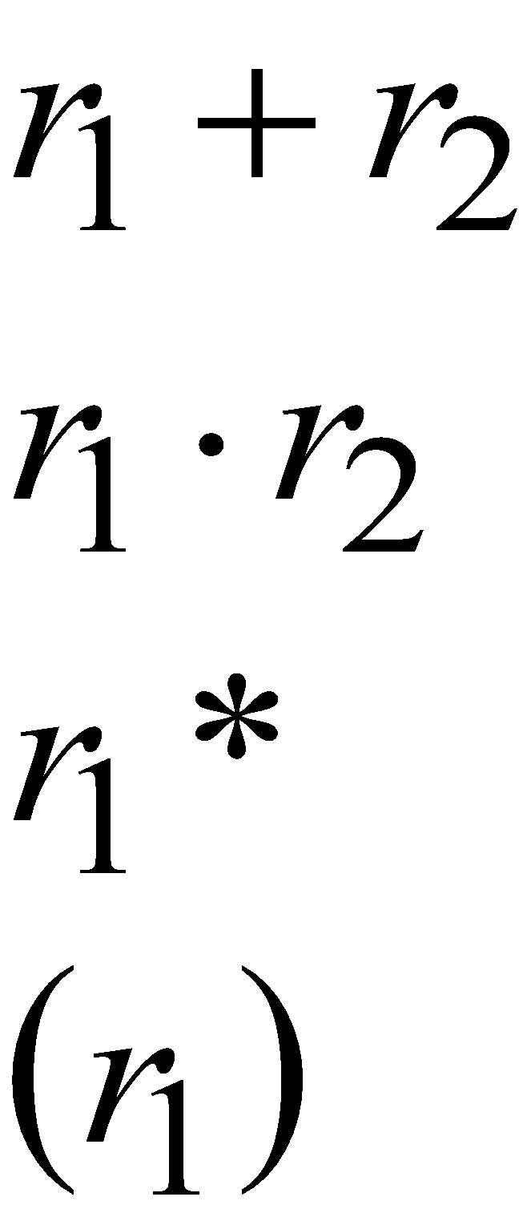
Recursive Definition
Given regular expressions and
Are regular
Expressions
27

Slide 28
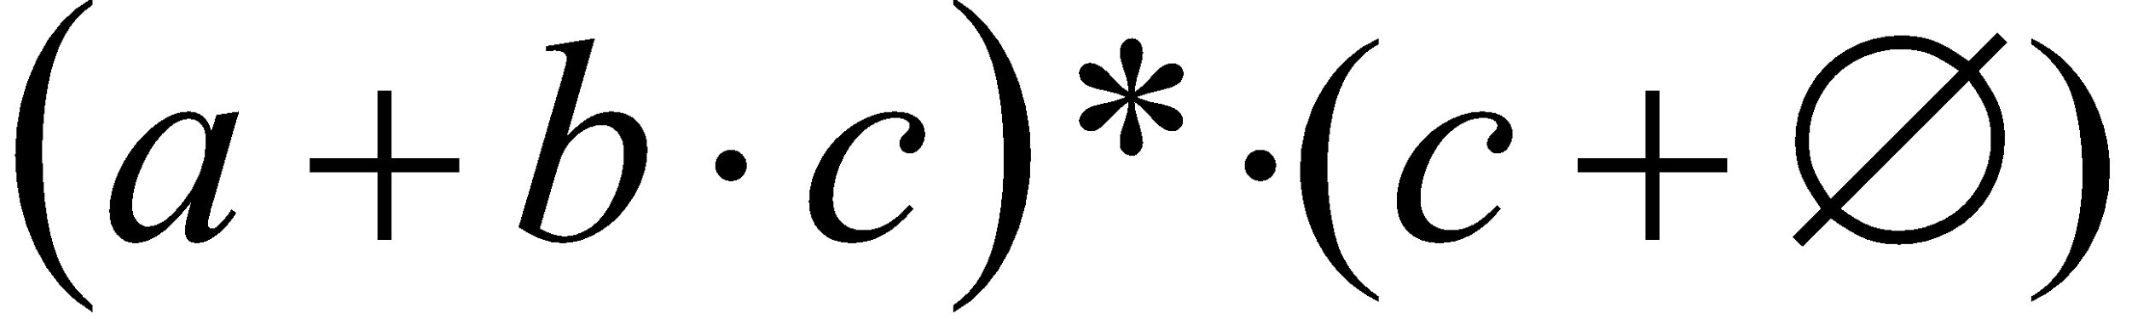
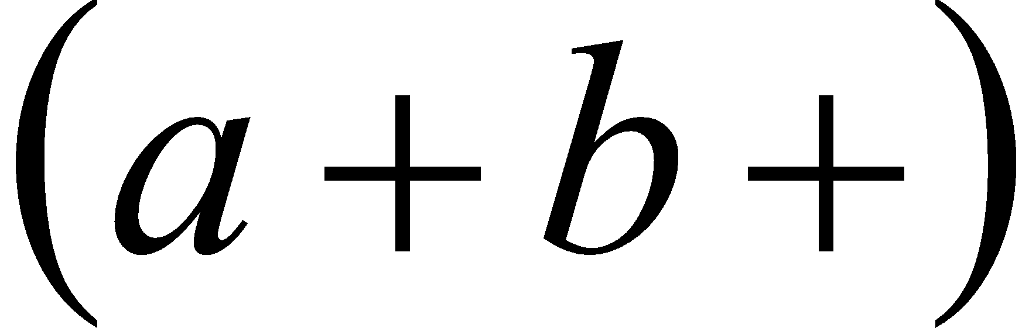
Regular Expressions
A regular expression:
Not a regular expression:
28

Slide 29
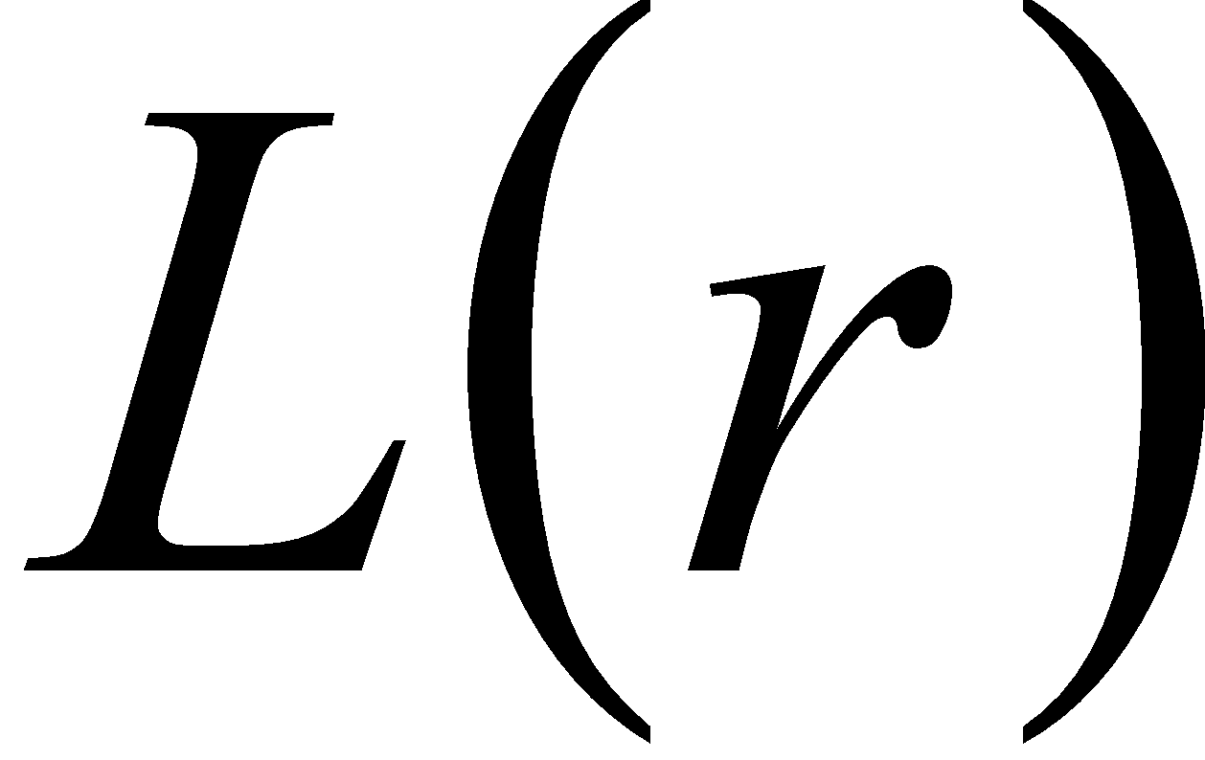

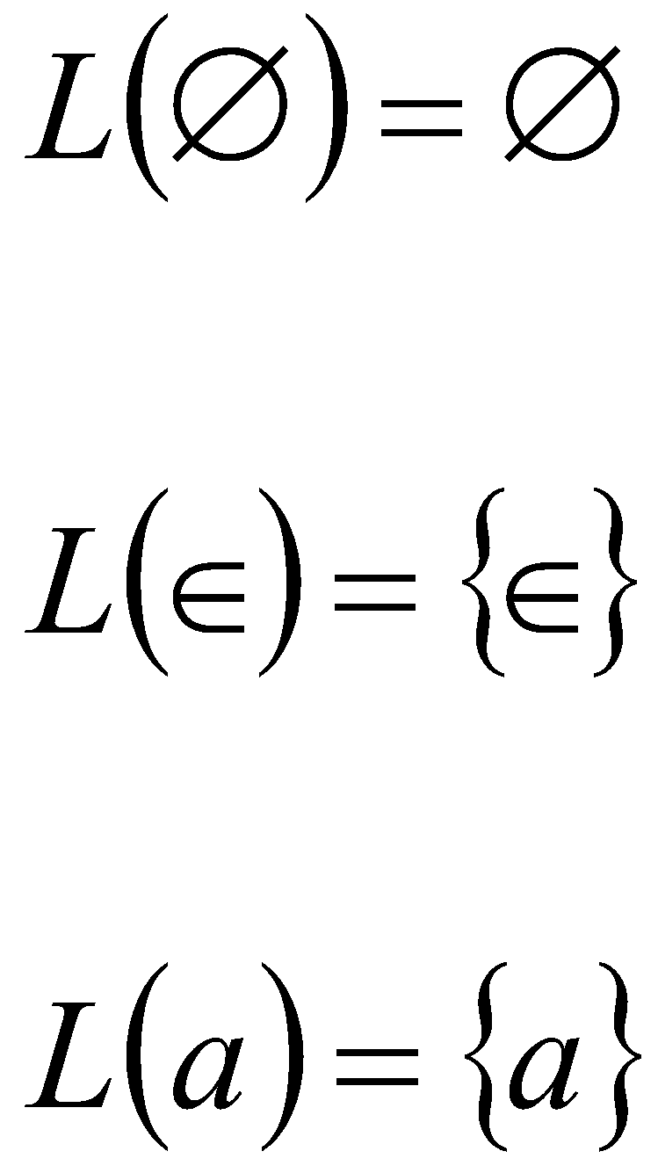
Regular Expressions
: language of regular expression
Example
29

Slide 30

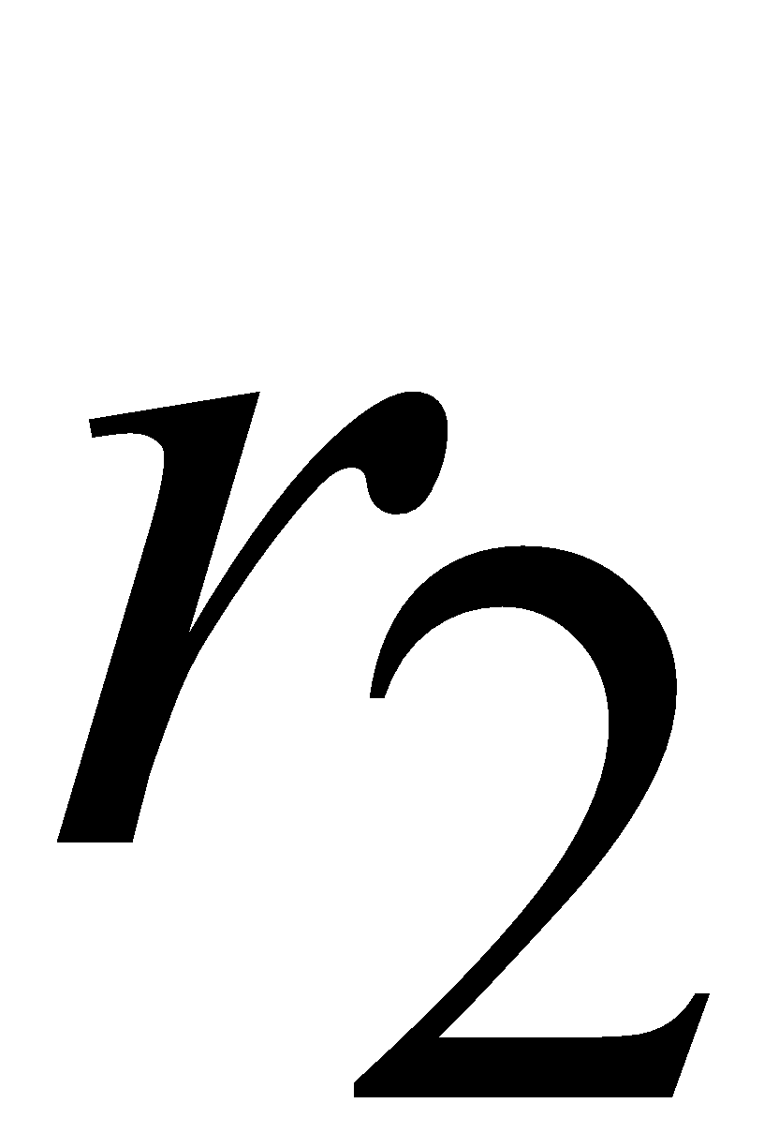
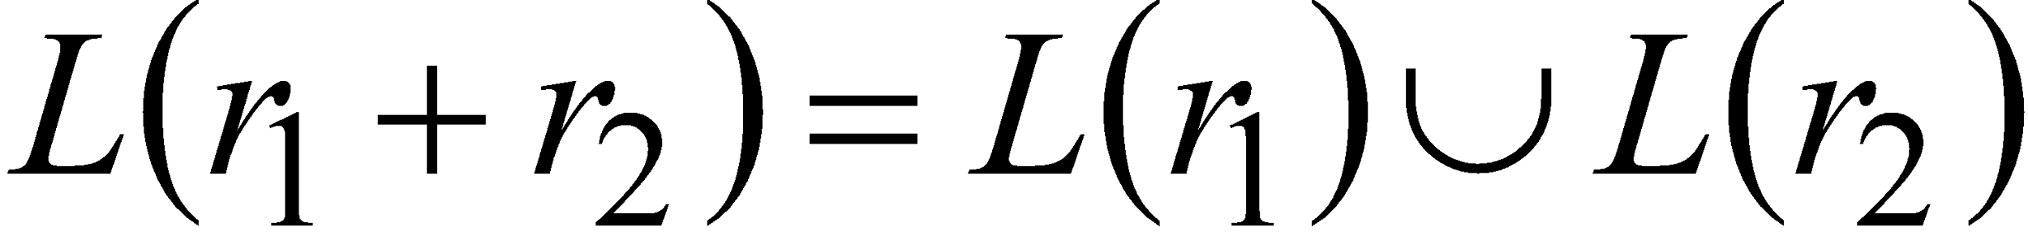
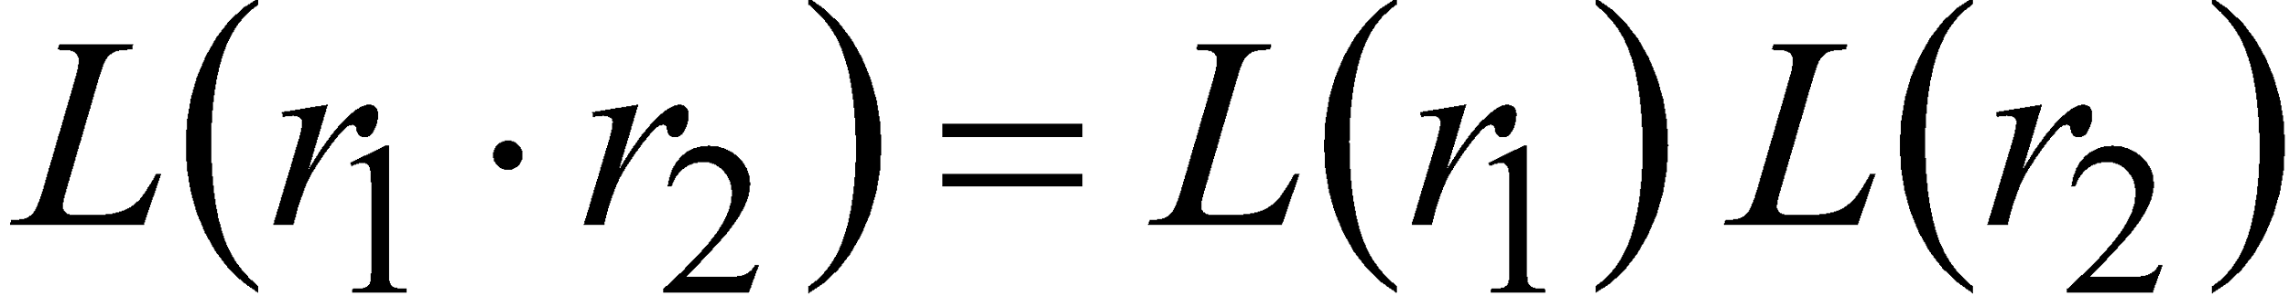

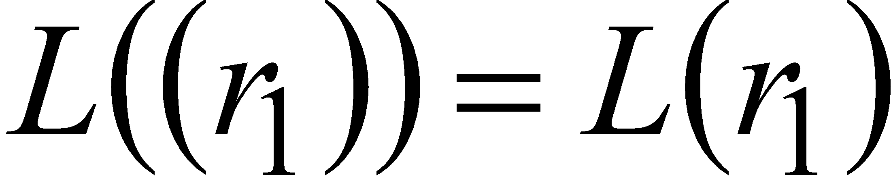
Regular Expressions
For regular expressions and
30

Slide 31
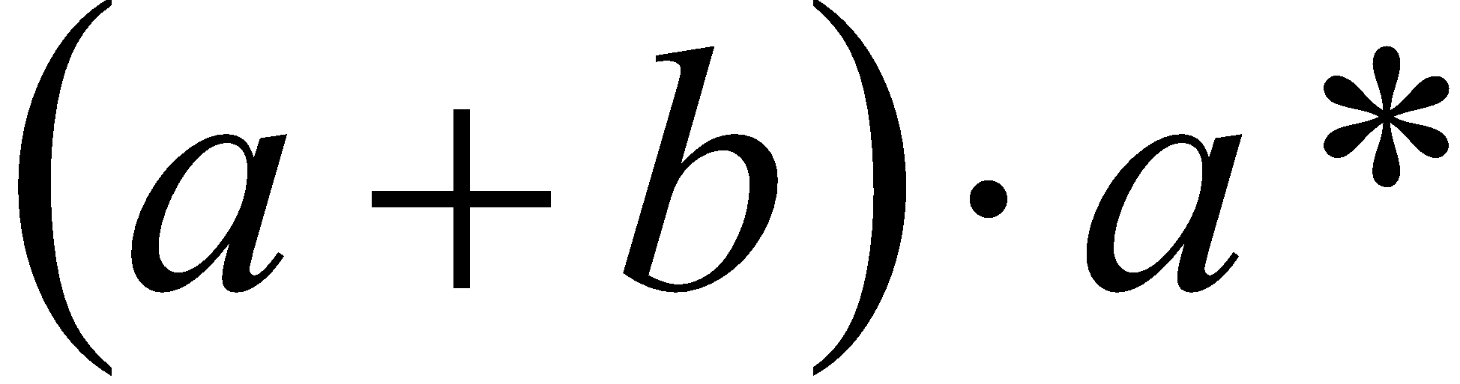

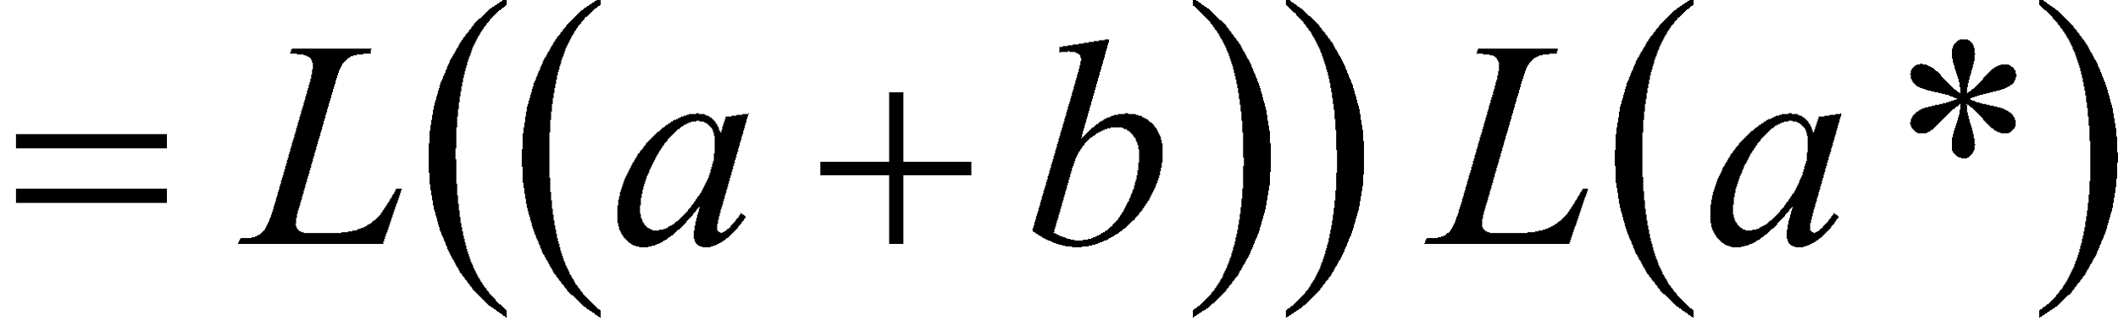
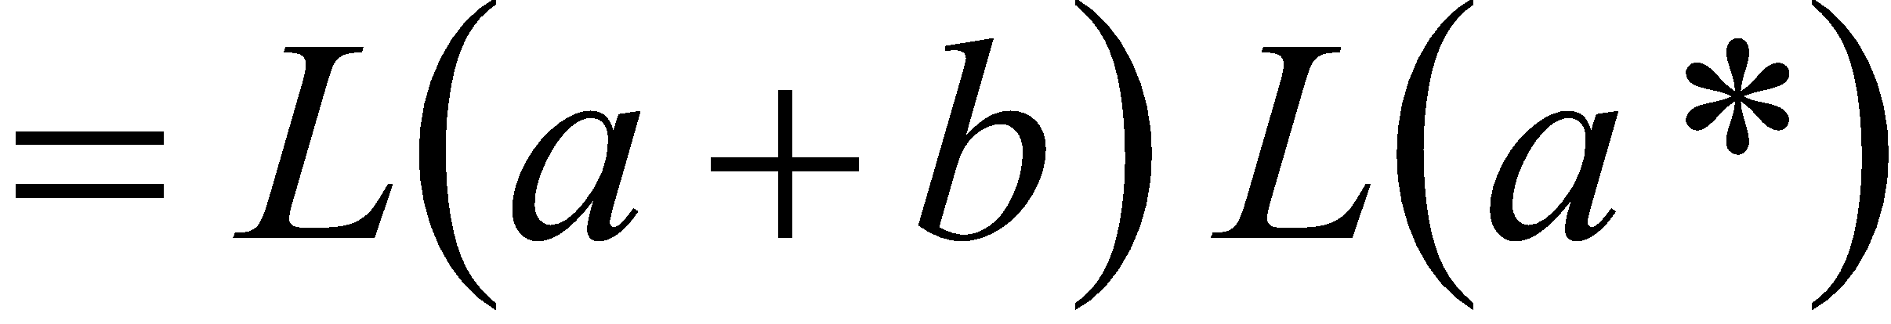


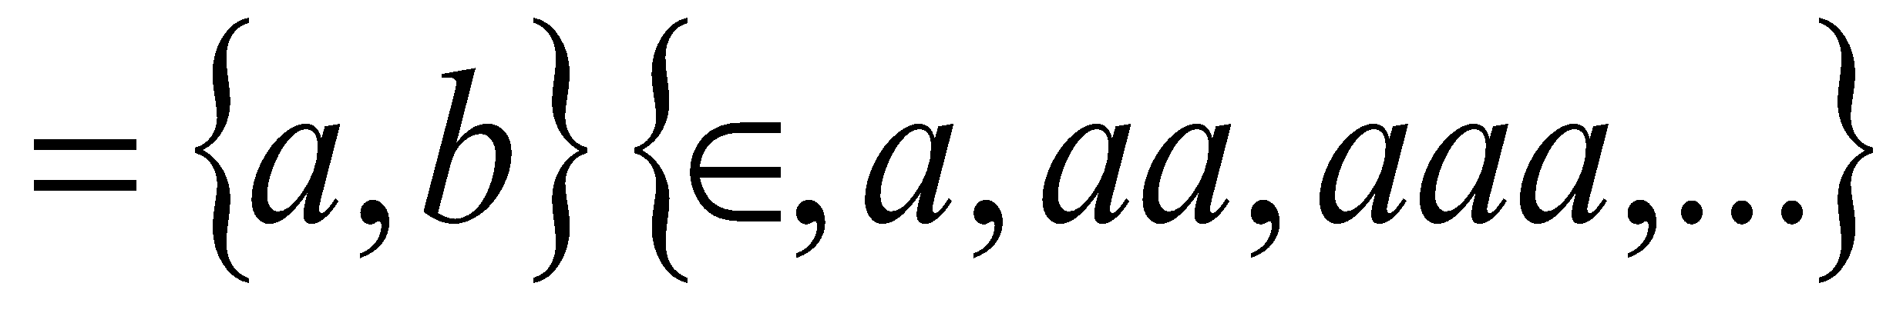
Regular Expressions
Regular expression:
31

Slide 32
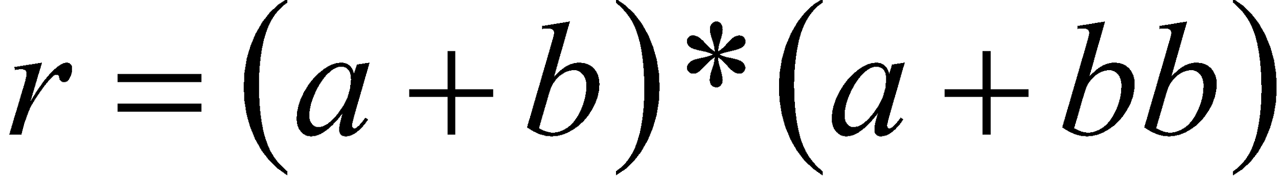
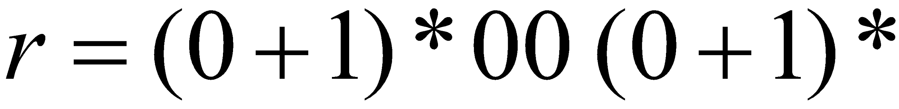
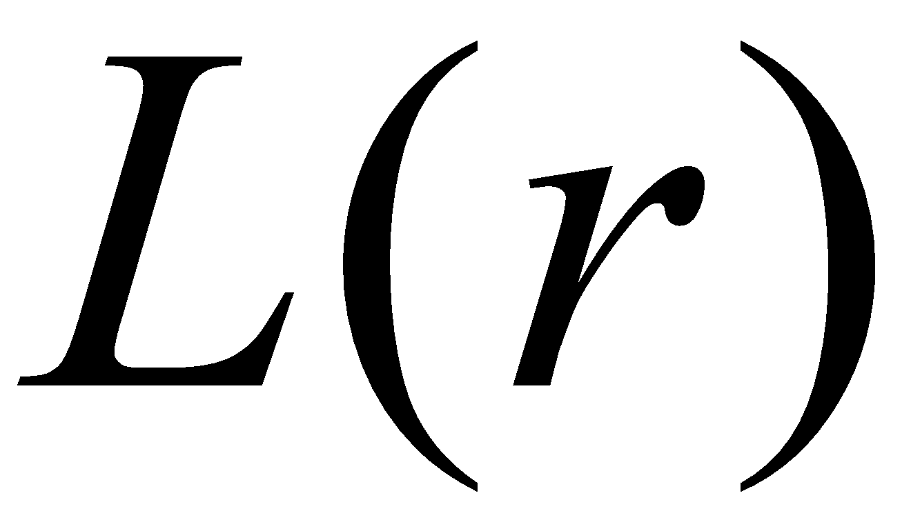
Regular Expressions
Regular expression
Regular expression
= { all strings containing substring 00 }
32

Slide 33
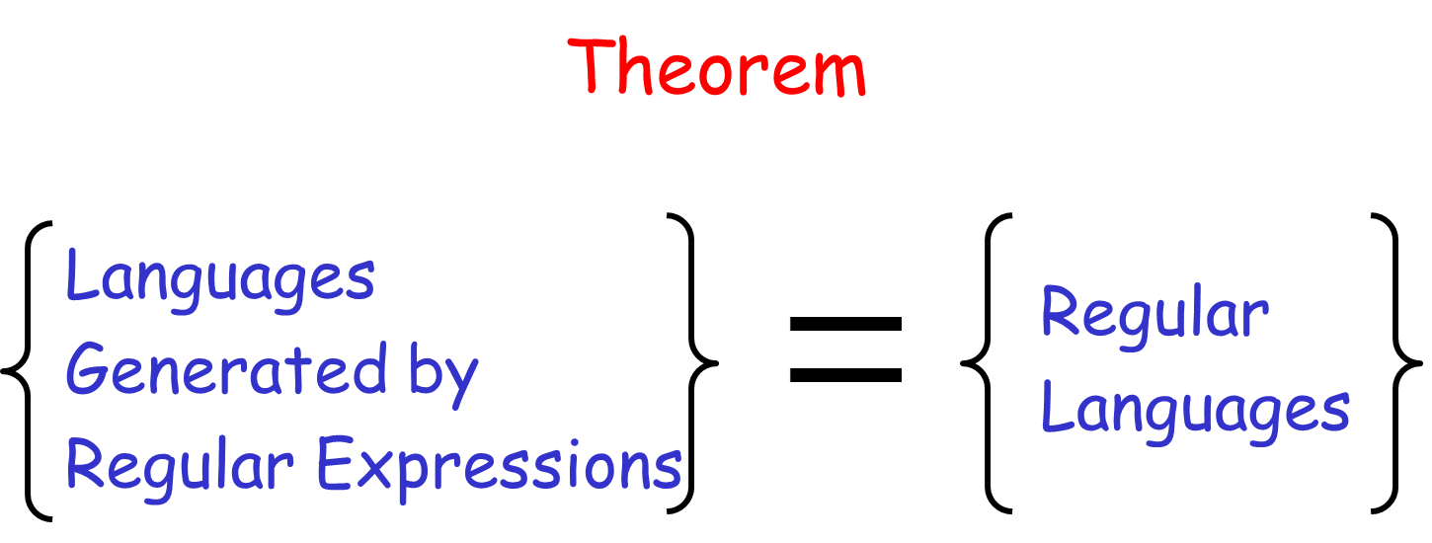
33

Slide 34
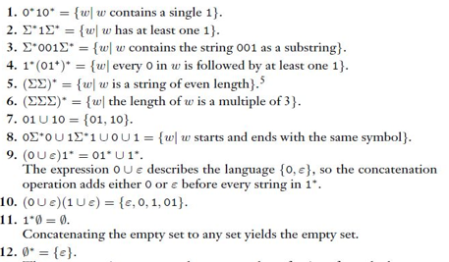
Example Problems in Regular Expressions
34

Slide 35
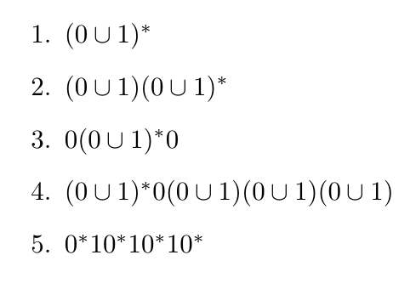
Solve Problems in Regular Expressions
35

Slide 36
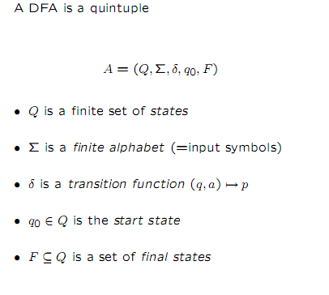
Deterministic Finite Automata (DFA)
36

Slide 37
Formal definition of DFA
DFA M = (Q, Σ, δ, s, F)
Where,
Q is finite set of states
Σ is input alphabet
s ∈ Q is initial state
F ⊆ Q is set of final states
δ: Q X Σ -> Q
37

Slide 38
DFA
The DFA has:
a finite set of states
1 special state - initial state
0 or more special states - final states
input alphabet
transition table containing
(state, symbol) -> next state
38

Slide 39
How does a DFA work?
After reading input string,
if DFA state final, input accepted
if DFA state not final, input rejected
Language of DFA -- set of all strings accepted by DFA.
39

Slide 40
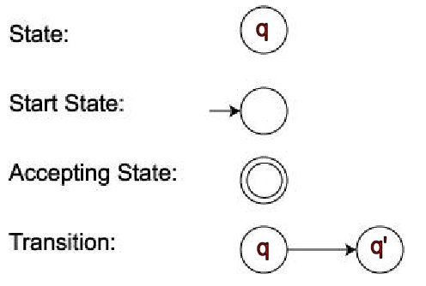
Pictorial representation of DFA
(q,σ) -> q'
40

Slide 41
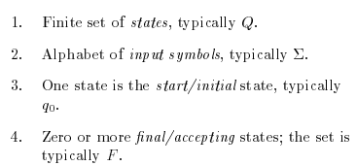
Formal definition of FA
41

Slide 42
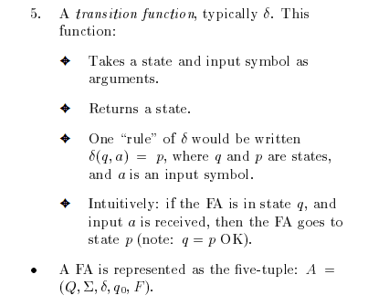
42

Slide 43
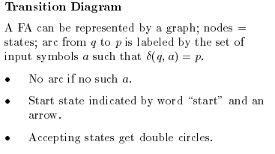
Transition Diagram
43

Slide 44
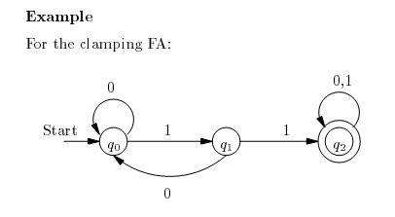
Example
44

Slide 45
Transition table
A transition table is a conventional tabular representation of functions like δ that takes the two argument and returns another state.
The row of the table corresponding to the states.
The column of the table corresponding to the inputs.
45

Slide 46
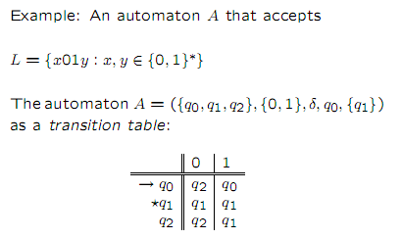
Example
46

Slide 47
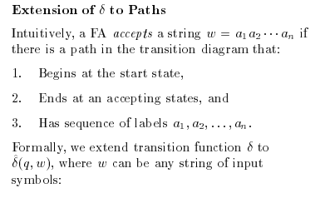
Extending the Transition functions to the strings
47

Slide 48
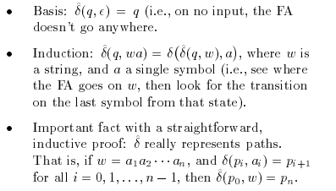
48

Slide 49
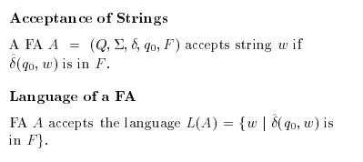
Language of DFA
49

Slide 50
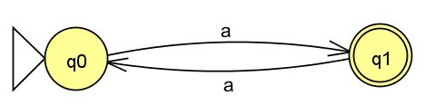
Example: Diagram of DFA L = {a^{2n + 1} | n >= 0}
Answer:
L = {a, aaa, aaaaa, ...}
50

Slide 51
Given a DFA accepting the following language over the alphabet {0,1} Set of all the strings ending with 00.
Problem 1
51

Slide 52
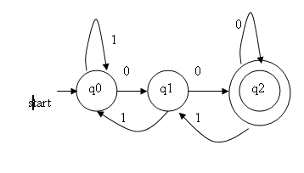
In this problem ,
“00” as 2 inputs and it needs 3 states
52

Slide 53
Formal definition of L(M)
L(M) - Language accepted by M
Define δ*:
δ*(q, ε) = q
δ*(q, wσ) = δ(δ*(q,w),σ)
Definition: L(M) = { w in Σ* | δ* (s,w) in F }.
53

Slide 54
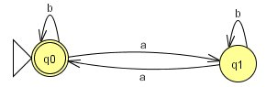
Example: L(M) = {w in {a,b}* | w contains even no. of a's}
Problem 2
54

Slide 55
Regular Languages
Definition: A Language is regular iff there is a DFA that accepts it.
Examples:
φ
{ε}
Σ*
{w in {0,1}* | second symbol of w is a 1} Exercise
{w in {0,1}* | second last symbol of w is a 1} Exercise
{w in {0,1}* | w contains 010 as a substring} - (importance?)
55

Slide 56
Closure properties of Regular Languages
Regular languages are closed under:
Union
Notation: ∪
Intersection
Notation: ∩
L₁ ∪ L₂ is regular if L₁ and L₂ are regular.
L₁ ∩ L₂ is regular if L₁ and L₂ are regular.
56

Slide 57
Examples
Let Σ = {a,b}.
Let L₁ = { w in Σ* | w has even number of a's}.
Is L₁ regular?
L₂ = { w in Σ* | w has odd number of b's}.
Is L₂ regular?
L₁ ∪ L₂ = ?
Ans: {w in Σ* | w has even a's or odd b's}.
L₁ ∩ L₂ = ?
Ans: {w in Σ* | w has even a's and odd b's}.
By closure properties, both these are regular.
57

Slide 58
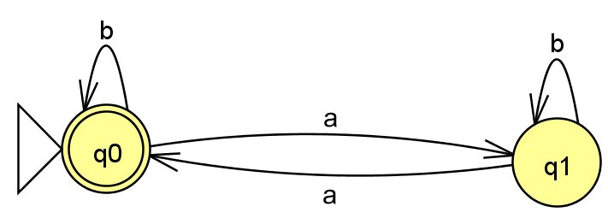
DFA of L₁ = {w in {a,b}* | w has even number of a's}.
Problem 3
58

Slide 59
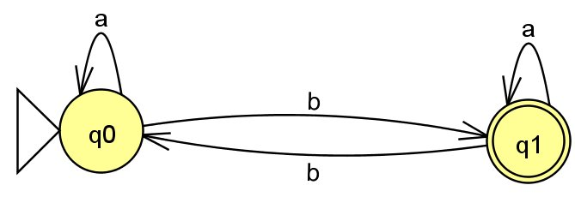
DFA of L₂ = { w in {a,b}* | w has odd number of b's}.
Problem 4
59

Slide 60
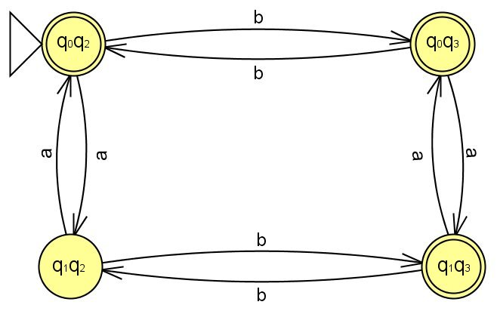
DFA of L₁ ∪ L₂ = {w in {a,b}* | w has even a's or odd b's}.
Problem 5
60

Slide 61
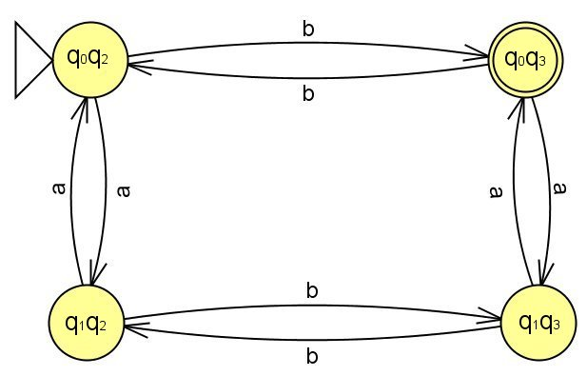
DFA of L₁ ∩ L₂ = {w in {a,b}* | w has even a's and odd b's}.
Problem 6
61

Slide 62
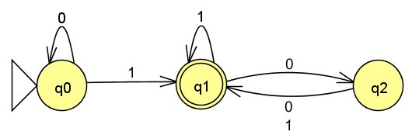
DFA of A = {w | w contains at least one 1 and an even number of 0s follow the last 1}
Problem 8
62

Slide 63
Given a DFA accepting the following language over the alphabet {0,1} Set of all the strings ending with 00.
Problem 9
63

Slide 64
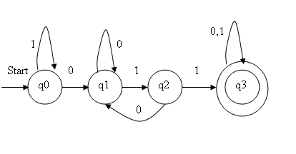
Problem 10 Given a DFA accepting the following language over the alphabet {0,1} Set of all the strings with 3 consecutive 0’s (not necessarily at the end).
64

Slide 65
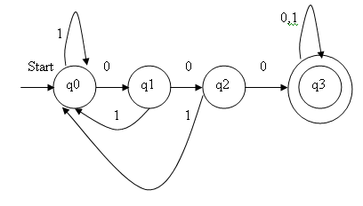
Problem 11: Given a DFA accepting the following language over the alphabet {0,1} Set of all the strings with a 011 as a substring.
65

Slide 66
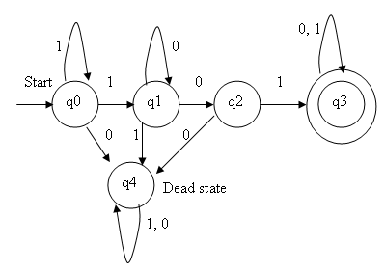
Given a DFA accepting the following language over the alphabet {0,1} Set of all the strings beginning with a 101.
Problem 13
66

Slide 67
Given a DFA accepting the following language over the alphabet {0,1} Set of all the strings with three consecutive zeros.
Problem 14
67

Slide 68
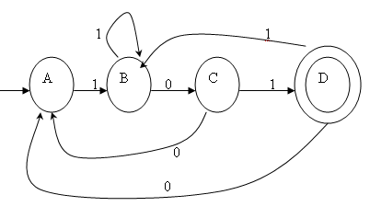
: Consider the following transition diagram and to check the input string 110111,011101 is accepted or not.
Problem 14
68

Slide 69
Transition table:
Let A be a DFA which has A={Q,∑,δ,q0,F)
 | 0 | 1
🡪 A | A | B
B | C | B
C | A | D
* D | A | B
69

Slide 70
Input: 110111
δ( A,є) =A.
δ( A,1) =B.
δ( A,11) =δ( A,1),1) =δ( B,1) =B.
δ( A,110) =δ( A,11),0) =δ( B,0) = C.
δ( A,1101) =δ( A,110),1) =δ( C,1) = D.
δ( A,11010) =δ( A,1101),0) =δ( D,1) = B.
δ( A,110101) =δ( A,11010),0) =δ( B,1) = B.
It does not reach the final state.
The given string is not accepted by DFA.
70

Slide 71
Input: 011101
δ( A,є) =A.
δ( A,0) =A.
δ( A,01) =δ( A,0),1) =δ( A,1) =B.
δ( A,011) =δ( A,01),1) =δ( B,1) = B.
δ( A,0111) =δ( A,011),1) =δ( B,1) = B.
δ( A,01110) =δ( A,0111),0) =δ( B,0) = C.
δ( A,011101) =δ( A,011101),0) =δ( C,1) = D.
It reaches the final state.
The given string is accepted by DFA.
71

Slide 72
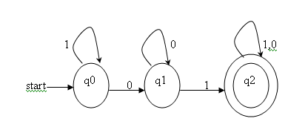
Give a DFA accepting the following language over the alphabet {0,1}. All the strings with a substring 01 and to check the given input string 10010 is accepted or not by a DFA.
Problem 15
 | 0 | 1
q0 | q1 | q0
q1 | q1 | q2
*q2 | q2 | q2
72

Slide 73
Input 10010
δ( q0,є) =q0.
δ( q0,1) =q0.
δ( q0,10) =δ( q0,1),0) =δ( q0,0) =q1.
δ( q0,100) =δ( q0,10),0) =δ( q1,0) =q1.
δ( q0,1001) =δ( q0,100),1) =δ( q1,1) =q2.
δ( q0,10010) =δ( q0,1001),0) =δ( q2,0) =q2.
It reaches the final state
The given string is accepted by DFA.
73

Slide 74
Problem16 : Design a DFA to accept the language L ={w/w has an even number of 0’s and even number of 1’s}and to check the given input strings are 110101 and 10010 is accepted or not by an DFA.
It has the 4 states like q0,q1,q2,q3.
q0: Number of 1’s and number of 0’s are even.
q1: Number of 0’s is even and number of 1’s is odd.
q2: Number of 0’s is odd and number of 1’s is even.
q3: Number of 0’s and number of 1’s are odd.
74

Slide 75
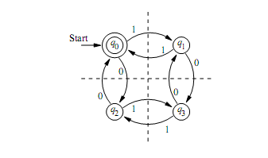

Let A be a DFA which has A={Q,∑,δ,q0,F)
Transition diagram:
75

Slide 76
Input: 110101
δ( q0,є) =q0.
δ( q0,1) =q1.
δ( q0,11) =δ( q0,1),1) =δ( q1,1) =q0.
δ( q0,110) =δ( q0,11),0) =δ( q0,0) =q2.
δ( q0,1101) =δ( q0,110),1) =δ( q2,1) =q3.
δ( q0,11010) =δ( q0,1101),0) =δ( q3,0) =q1.
δ( q0,110101) =δ( q0,11010),0) =δ( q1,1) =q0.
It reaches the final state. The given string is accepted by DFA.
76

Slide 77
Input: 10010
δ( q0,є) =q0.
δ( q0,1) =q1.
δ( q0,10) =δ( q0,1),0) =δ( q1,0) =q3.
δ( q0,100) =δ( q0,10),0) =δ( q3,0) =q1.
δ( q0,1001) =δ( q0,100),1) =δ( q1,1) =q0.
δ( q0,10010) =δ( q0,1001),0) =δ( q0,0) =q2.
The state q2 is not a accepting state.
The given string is not accepted by DFA.
77

Slide 78
Nondeterministic Finite Automaton (NFA)
Generalization of DFA. Allows:
0 or more next states for the same (q, σ).
Guessing
Transitions labeled by the empty string.
Changing state without reading input
Motivation: Flexibility.
Easier to prove many closure properties.
78

Slide 79
How does an NFA work?
w is accepted by an NFA provided there is a sequence of guesses that leads to a final state.
Language accepted by NFA is the set of all strings accepted by it.
79

Slide 80

Nondeterministic Finite Automata:
Generalize FAs by adding nondeterminism,allowing several alternative computations on the same input string.
Ordinary deterministic FAs follow one path on each input.
80

Slide 81

Nondeterministic Finite Automata:
81

Slide 82



Nondeterministic Finite Automata:
NFA Example
82

Slide 83


Nondeterministic Finite Automata:
NFA Example
83

Slide 84

Example: {w in {0,1}* | the second last symbol of w is a 1}
Problem 1
84

Slide 85
Formal definition of NFA
Notation: Σ_{e} = Σ U {e}.
NFA M = (Q, Σ, Δ, s, F) where:
Q - finite set of states
Σ - input alphabet
s - initial state
F ⊆ Q - set of final states
Δ is a subset of Q X Σ_{e} X Q.
If (p, u, q) in Δ, then NFA in state p can read u and go to q.
85

Slide 86
Formal definition of NFA acceptance
Define Δ*(q, w) as a set of states: p ε Δ*(q, w) if there is a directed path from q to p labeled w
Example: consider NFA of Lecture 3
Δ*(q₀, 1) = ?
Ans: {q₀, q₁}
Δ*(q₀, 11) = ?
Ans: {q₀, q₁, q₂}
86

Slide 87
NFA acceptance
w is accepted by NFA M iff Δ*(q₀, w) ∩ F is nonempty.
L(M) = {w in Σ* | w is accepted by M}.
87

Slide 88
NFA vs. DFA
Is NFA more powerful than DFA?
Ans: No.
Theorem:
For every NFA M there is an equivalent DFA M'
Proof Idea:
NFA is in a set of states at any point during reading a string.
DFA will use a lot of states to keep track of this.
Important Assumption:
No transition labeled by epsilon.
(Will get rid of this assumption later.)
88

Slide 89
Equivalent DFA construction
NFA M = (Q, Σ, Δ, s, F)
DFA M' = (Q', Σ, δ, s', F') where:
Q' = 2^{Q}
s' = {s}
F' = {P | P ∩ F is nonempty}
δ({p₁, p₂, p_{m}}, σ) = Δ*(p₁, σ) ∪ Δ*(p₂, σ) ∪ ... ∪ Δ*(p_{m}, σ)
i.e. find all the states that can be reached on σ from all the NFA states in a DFA state.
89

Slide 90
Example: Equivalent DFA construction
NFA
90

Slide 91

Equivalent DFA construction
91

Slide 92

How to handle epsilon transitions?
Define e-closure of state q as Δ*(q, ε).
notation: e-closure(q).
Example:
92

Slide 93
Handling epsilon transitions (contd.)
Extend e-closure to sets of states by:
e-closure({s₁, ... , s_{m}}) = e-closure(s₁) ∪ ... ∪ e-closure(s_{m})
Now let
s' = e-closure({s}).
and,
δ({p₁,..., p_{m}}, σ) = e-closure(Δ*(p₁, σ)) ∪ ... ∪ e-closure(Δ*(p_{m}, σ))
to complete construction of DFA.
93

Slide 94

Example: Handling epsilon transitions.
94

Slide 95

DFA = ?
95

Slide 96
Language Operations
Concatenation. Notation: L∙L' or just LL'
L ∙ L' = {uv | u in L, v in L'}.
Kleene Star. Notation: L*
L* = { w in Σ* | w = w₁...w_{k} for some k >= 0 and each w_{i} in L}.
Examples: if L = {a^{(2n+1)} | n >= 0}. L' = {b^{(2n)} | n > = 0}.
LL' = ?
Ans: LL' = {a^{(2n+1)} b^{(2m)} | n, m > = 0}
L* = ?
Ans: {a^{n} | n >= 0}
U, ., * are called regular operations.
96

Slide 97
Closure properties of regular languages.
Previously we saw closure under ∪ and ∩.
New: Regular languages are closed under
Concatenation
Kleene star
Complement.
97

Slide 98
Examples
L = {w in {a,b}* | w has even a’s }
98

Slide 99

Examples
L' = {w in {a,b}* | w has at least one b}
99

Slide 100

Construction for L∙L'
L’’ = (K,Σ,Δ,s,F) K = K₁ ∪ K₂ s = s₁ F = F₂ Δ = Δ₁ ∪ Δ₂ ∪ F₁ X {e} X {s₂}
100

Slide 101


L* and L'*
L*
M = (K, Σ, Δ, s, F) K = {s} ∪ K₁ F = {s} ∪ F₁ Δ = Δ₁ ∪ F₁ X {e} X {s₁} ∪ {(s, e, s₁)}
Given M₁ = (K₁, Σ, Δ₁, s₁, F₁)
L’*
101

Slide 102


Complement of L and L'
Complement of L
Complement of L’
102

Slide 103
General Construction for Complement
DFA M = (K, Σ, δ, s, F) K = K₁ s = s₁ F = K - F₁ δ = δ₁
L(M) = Complement of L(M₁)
DFA M₁ = (K₁, Σ, δ₁, s₁, F₁)
Exercise: Will this construction work for NFAs?
Explain your answer.
103

Slide 104


Regular expressions versus FA's
Regular expressions generate exactly the class of regular languages.
Theorem:
(a) For every regular expression there is an equivalent NFA
(b) For every DFA there is an equivalent regular expression.
Proof of (a):
For φ, the NFA is:
For σ, the NFA is:
For composite regular expressions: use closure under ∪, ∙ and *
104

Slide 105
Parse Tree for (a U b)* ∙ b
∙
*
b
U
a
b
105

Slide 106



Example: NFA for (a U b)*b
a
b
aUb
106

Slide 107

Example (contd.) : NFA for (a U b)*b
(aUb)*
107

Slide 108

Example (contd.) : NFA for (a U b)*b
(a U b)*b
108

Slide 109
DFA → regular expression
Easier to do:
DFA → GNFA → regular expression.
GNFA (Generalized NFA)
labels of transitions can be regular expressions.
Need special GNFA that satisfies:
(1) start state has no incoming transition
(2) only one final state
(3) final state has no outgoing transition.
109

Slide 110
DFA → regular expression (contd.)
Idea:
Convert DFA → special GNFA.
Eliminate all states, except start and final state, one state at a time.
Output the label on the single transition left at the end.
110

Slide 111

Eliminating state q{rip}
R₄
q_{i}
q_{j}
R₁
R₃
q_{rip}
(R₁ )(R₂)* (R₃) ∪ (R₄)
R₂
q_{i}
q_{j}
111

Slide 112

Constructing regular expression.
DFA L = {w in {a, b}* | w has odd number of b's }
112

Slide 113

Constructing regular expression (contd.)
Added: a new start state and a new final state with empty transitions
113

Slide 114

Constructing regular expression (contd.)
Eliminate states one-by-one
q_{rip}
Before we take out q_{rip}, we have to see
all the paths to the q_{rip} state and
all possible transitions.
We take out the q_{rip} state and it leaves us with a 3 state Finite Automata
114

Slide 115

Constructing regular expression (contd.)
q_{rip}
We take out the q_{rip} state and we are left with the regular expression
115

Slide 116
Converting NFA to DFA
116

Slide 117


Converting NFA to DFA
117

Slide 118

Converting NFA to DFA
118

Slide 119

Converting NFA to DFA
119

Slide 120

Converting NFA to DFA
120

Slide 121

Converting NFA to DFA
121

Slide 122

Converting NFA to DFA
122

Slide 123

123

Slide 124

124

Slide 125

125

Slide 126

126

Slide 127

127

Slide 128

128

Slide 129

129

Slide 130

130

Slide 131

131

Slide 132

132

Slide 133


133

Slide 134
134

Slide 135

Applications of the Pumping Lemma
135

Slide 136

136

Slide 137

Applications of the Pumping Lemma
137

Slide 138


138

Slide 139

139

Slide 140


140

Slide 141

141

Slide 142

CLASSIFICATION OF FINITE AUTOMATON
142

Slide 143
FINITE AUTOMATON WITH OUTPUTS
Finite automata is always associated with FSM.
DFA, NFA, epsilon NFA : tells whether the input is accepted or not.
The finite automata that generates some output:
Mealy Machines
Moore Machines
143

Slide 144


Mealy state machine
In the theory of computation, a Mealy machine is a finite state transducer that generates an output based on its current state and input.
This means that the state diagram will include both an input and output signal for each transition edge. This maps transitions in the machine to outputs.
This has reduced number of states
144

Slide 145

Mealy state machine
145

Slide 146


Moore state machine
In the theory of computation, a Moore machine is a finite state transducer where the outputs are determined by the current state alone (and do not depend directly on the input).
The state diagram for a Moore machine will include an output signal for each state. The transitions are not directly dependent upon input.
The advantage of the Moore model is a simplification of the behavior
146

Slide 147

Moore state machine
147

Slide 148

MEALY MACHINE VS MOORE MACHINE
148

Slide 149
Design a Mealy machine that prints ‘A’ if the sequence ‘110’ is encountered
Solution:
Construct a DFA that accepts strings containing ‘110’ as substring.
149

